Slide 1
Team Mystic
Yinghua Qin
Thol Chidambaram
Mitesh Kumar
Srivatsa Mulpuri
Vidhi Sharma

Slide 2
Screens:
1.Login
- Functionalities:
Button animation (Digits press animation)
On click event on the buttons
Pin check (Default pin-1234)
2.MyCards
- Functionalities
Button animation
On click event on bottom menu and other buttons
Displays correct card amount value
3.Pay
- Functionalities
Button animation (button click)
Scan animation
On click event on bottom menu and buttons
Displays correct card id value

Slide 3
4.MoreOptions
- Functionalities
On click event on menu and other buttons
Displays correct card amount value
5.Settings
- Functionalities
On click event on bottom menu animation (Add Card and Set Pin buttons)
6. Add Card Screen
-- Functionalities
Button animation (Digits press animation)
On click event on the buttons (Add card id, card code, add)
Reset pin (After resetting pi back to login screen)
6. Payment Setup
7. Rewards
8. Find Store

Slide 4
Design Pattern Used
Command
State
Observer,
Builder
Visitor,
Adapter

Slide 5
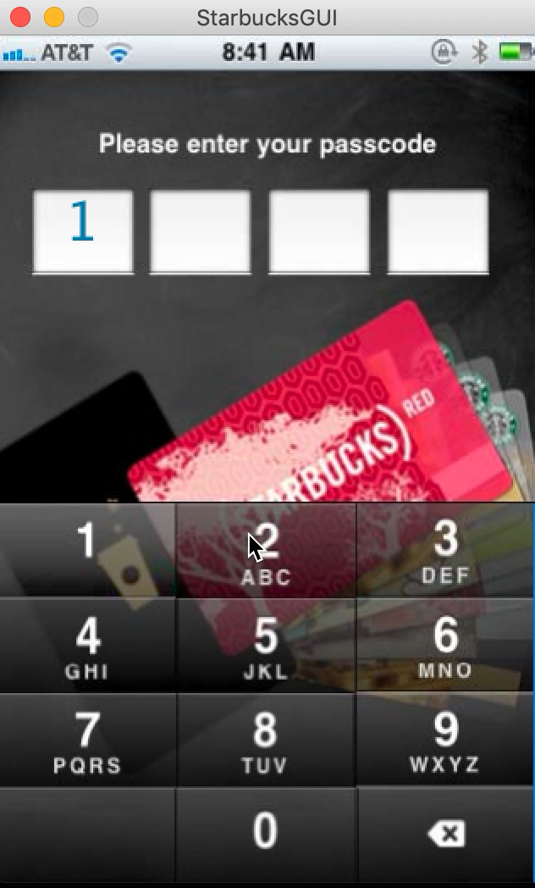
Demo

